Slide 1
4-26-2025 Windows Tutorial
https://github.com/geegaz/Multiple-Windows-tutorial

Slide 2
Notes while doing the multiple window tutorial
https://forum.godotengine.org/t/difference-between-equals-and-colon-equals/14304
The “:=“ is a static typing method

Slide 3
Rereading Introduction to Godot (3rd time?)
https://docs.godotengine.org/en/stable/getting_started/introduction/learn_to_code_with_gdscript.html#learn-in-your-browser-with-the-gdscript-app
I think this is new . . . it seems cool.
wow, python and GDScript have something called “negative array indices” which works really differently from C++
oh, so that’s how a dictionary/hashing works . . . cool factoid to include.
GDScript has the int / int = int thing going on with its dynamically typed variables . . . so you’ll want to either define data types or use “x.0”. Just be careful.
data type for string is “String” even though the constructor is “str()”

Slide 4
Scene Diagram
Bathroom
Health
Happiness
Food
Water
Bed
Thirst
Satiety
Pause Signal
Actions
Books
Gym
Sports
Affection
Cleanliness, Excretion
Settings
Status
Environment
Model
Animations
Desktop Mate
UI
Game Scene

Slide 5
Godot Addons
Make a project
Copy the assets folder into the project folder
enable the plugins in the project settings
https://docs.godotengine.org/en/stable/tutorials/plugins/editor/installing_plugins.html

Slide 6
Godot-vrm
The plugin lets you go to scene > open scene and just select a .vrm file to open it.

Slide 7
navigating 3d scene
make sure you’re on perspective mode
right click and drag to rotate
right click and press wsad to move, eq also move up and down
shift to temporarily speed up; alt to temporarily slow down; mouse wheel should be permanent speed changes
https://docs.godotengine.org/en/stable/tutorials/3d/introduction_to_3d.html#d-viewport

Slide 8
about Godot skeletons . . .
https://docs.godotengine.org/en/3.0/tutorials/3d/working_with_3d_skeletons.html
https://github.com/slapin/godot-skel3d/blob/master/demo1/godot/arm-control.gd
no idea why there’s a Makehuman skin texture in the repository
the tutorial omitted the input key renaming file, but the github has that and it makes the if-else-if ladder in the process statement make more sense.
idea is that you use the process stuff to change the target bone rotation from the rest position and always transform the bone from its rest position
https://docs.godotengine.org/en/3.0/tutorials/3d/inverse_kinematics.html#doc-inverse-kinematics
The vrm skeletons are fine; just remember to click general skeleton. Plus there are tons of spring bones lying around and cluttering the interface, and the useful bones tend to be at the end of the list.

Slide 9
Getting started with skeletons (https://docs.godotengine.org/en/3.0/tutorials/3d/working_with_3d_skeletons.html)
#bones member function worked
try using get_bone_name() in a for loop to print out each bone’s name?
yep, that worked. Now I need to make a list of the important bone names – manually.
ooh, I can just copy-paste from the scene output
why is there “Root_” and “Root”?
in the bone hierarchy, Root is the top-level, but it’s only attached to Root_, and everything else is attached to Root_
https://github.com/vrm-c/vrm-specification/blob/master/specification/VRMC_vrm-1.0/humanoid.md
um . . . huh. Well, the vrm spec. only has 1 root bone. Dragging the bones around in Godot seem to have them work the same? Yeah, even rotations went the same way.
https://github.com/V-Sekai/godot-vrm/issues/60
The extension’s official bone chart only mentions “Root”, so I’d stick with that and ignore Root_
https://docs.godotengine.org/en/3.5/classes/class_transform.html
that’s the big mover for skeleton motion. It defines your local coordinate axes, both rotation and position, so 3 basis vectors + 1 position vectors forming a 4x3 matrix
the “rotated()” member variable rotates along an axis (1st argument, Vector3) and an angle/magnitude (2nd argument)
requires a normalized axes Vector3, which is prob. part of the reason the example writer just does x, y, and z rotations independently
probably uses the 4x3 matrix’s basis vectors for interpreting the rotated vector argument. But I need to test that.
Oh gosh, the Hip bone . . . rotates everything . . . b/c everything is also parented to the hip bone. So it’s another motherbone, really . . .

Slide 10
Important bone names; many left/right bones are not repeated
Root_
Hips
Spine
Chest
UpperChest
Neck
Head
LeftEye
RightEye
LeftUpperLeg
LeftFoot
LeftToes
RightUpperLeg
RigthLowerLeg
RightFoot
RightToes
Root
LeftShoulder
LeftUpperArm
LeftLowerArm
LeftHand
LeftIndexProximal
LeftIndexIntermediate
LeftIndexDistal
LeftLittleProximal
LeftLittleIntermediate
LeftLittleDistal
LeftMiddleProximal
LeftMiddleIntermediate
LeftMiddleDistal
LeftRingProximal
LeftRingIntermediate
LeftRingDistal
LeftThumbMetacarpal
LeftThumbProximal
LeftThumbDistal

Slide 11
I’m having trouble with inputs
Input Map isn’t working for me
_input(event): works, but that doesn’t mesh with processes . . .
online resources tell me to try restarting Godot, but that hasn’t been working for me.
okay, my function isn’t even working . . .
actually, the example code declares var newpose 3 times and doesn’t even run . . .
but I was also a silly Lambert and forgot to include set_bone_pose() 😭
so . . .the input map error doesn’t actually matter b/c the stuff works regardless—and overall the big issue was me forgetting set_bone_pose()
Code still has an issue where the lower arm rotations are occurring around the upper arm’s origin . . .
actually, both arms are suffering from this issue.

Slide 12
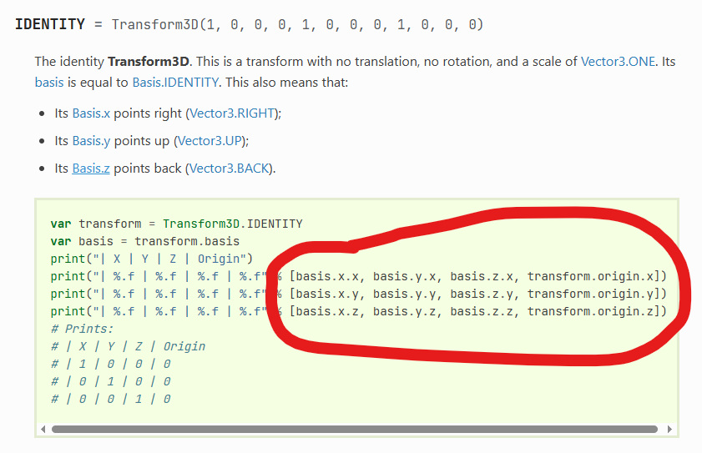
Bone origins
https://docs.godotengine.org/en/stable/classes/class_transform3d.html
found how to access this stuff, but they didn’t change anything
maybe the real issue is that transform.rotated() isn’t managing to account for the origin or rotation? Somehow?
needed to use transform.rotated_local(). And it works!!!
btw the spring bones are also working great

Slide 13
Animation System
https://docs.godotengine.org/en/stable/getting_started/step_by_step/signals.html#scene-setup
could use signals to turn animations on and off?
no . . . b/c you always want to have an animation running
use signals to change the animation
var current_animation = “idle.txt”
var previous_animation = “idle.txt”
var animation_runtime = 0.0
func _process(delta):
if current_animation == previous_animation:
animation_runtime += delta
run(current_animation)
else:
animation_runtime = 0.0
run(current_animation)
func _on_xyz(new_animation): current_animation = new_animation

Slide 14
Animation System Continued
an animation file is . . . a sequence of timestamped poses
it can just be a big list
each row contains:
bone moved, keyframe time, new bone position, interpolation style from previous
to interpolate you’ll need to know the future bone position, so it’s better to separate each bone’s keyframes into a separate section of the file . . .
need to name bones with strings b/c bone number correspondence differs between models due to spring-bones differing
interpolation formula I made up for (t1, x1) and (t2, x2) and style (s) on the next slide

Slide 15
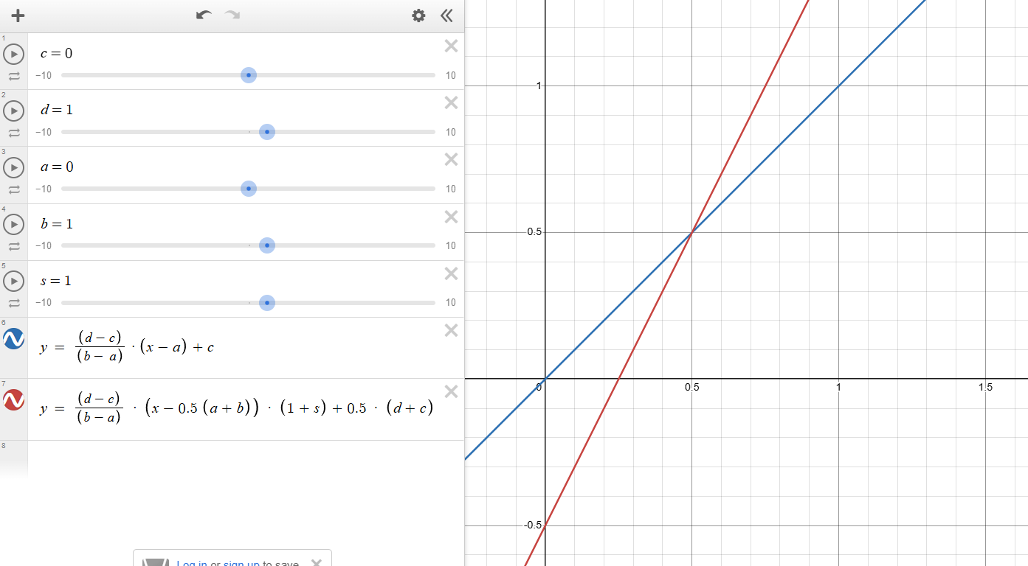
Interpolation Formula
Variables
a = t1
b = t2
c = x1
d = x2
s = s
x = t
Notice how the area under the curves is equal.
Oh . . . but I also need it to hit the boundary conditions . . . oops

Slide 16
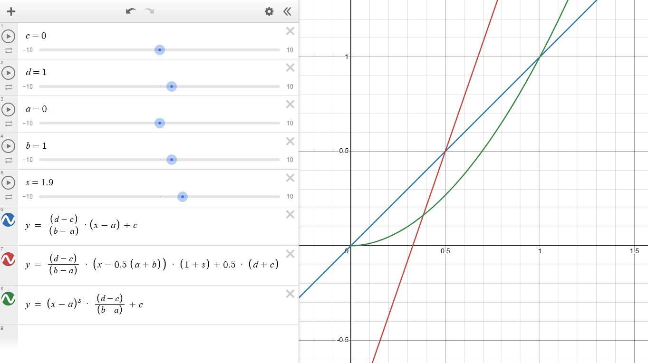
Proper Interpolation
s has to be between 0 and infinity instead of being any integer
critical point for s is now 1 instead of 0
meets boundary conditions, which is the important design spec (not area under curve, who cares about that . . .)
s > 1: starts slow and ends fast
0 < s < 1: starts fast and ends slow
b – a has to be 1 though . . . so this actually needs more scaling

Slide 17
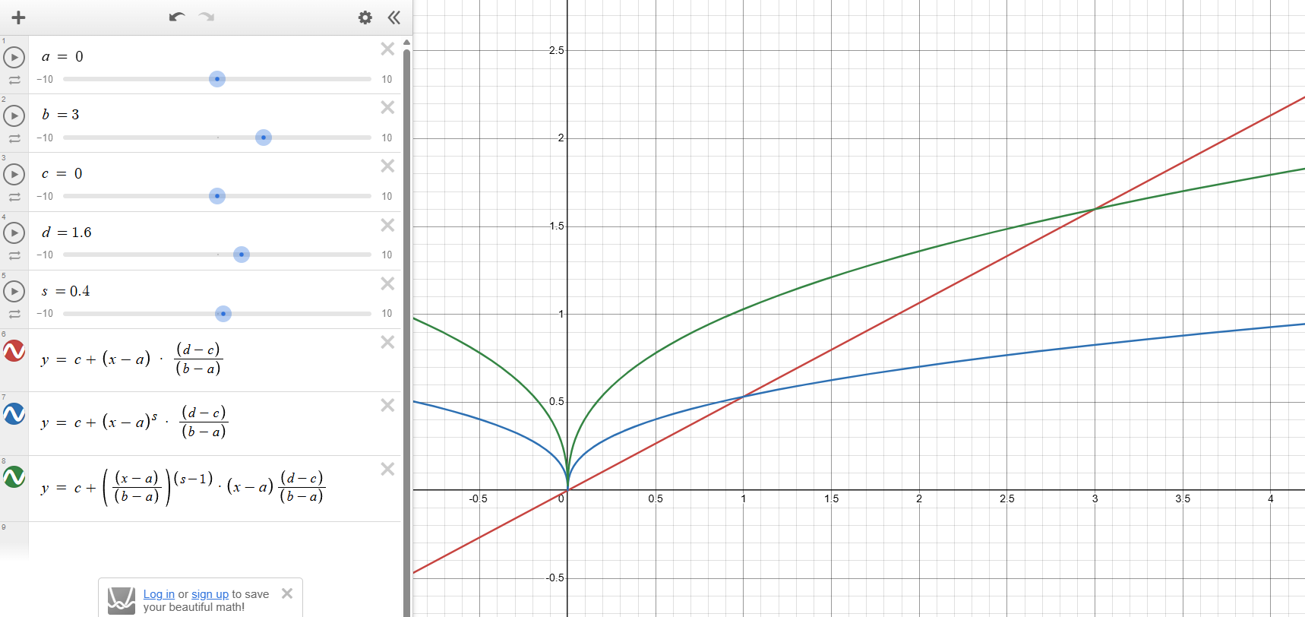
Actual Proper Interpolation
Interpolation needs to work when b != 1
by the way that’s just ((x-a) / (b – a))^s * (d – c) + c

Slide 18
Working with Files
https://docs.godotengine.org/en/stable/classes/class_fileaccess.html
https://docs.godotengine.org/en/stable/tutorials/io/data_paths.html
use forward slashes
“res://example.txt” for read-only things, like vrm animation files
“user://example.txt” for write and/or read things, like save files

Slide 19
Keeping things truly open-source
https://www.reddit.com/r/gamedev/comments/15qbip/how_to_make_your_game_moddable/
so, want almost everything in a txt file
https://docs.godotengine.org/en/stable/tutorials/scripting/nodes_and_scene_instances.html
which means I’ll want to load my characters via code from a file
I think .vrm files are scenes . . . yep. Need to load/preload -> instantiate -> add_child
it doesn’t show up in the editor’s scene tree, but that’s natural . . .
also, this should make launching minigames from scenes, whether made by me or somebody else, pretty simple
https://forum.godotengine.org/t/attaching-a-script-to-an-instances-scene-via-code/51351/2
use set_script() to add my script to the loaded character
https://forum.godotengine.org/t/there-are-have-some-ways-to-view-scene-tree-when-project-running/33755
Gemini says get_script() is a function to see if set_script worked
the script is attaching but not running . . .
https://forum.godotengine.org/t/child-scenes-scripts-not-running/70265/2

Slide 20
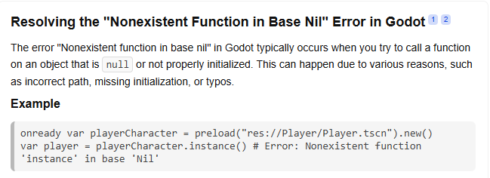
Troubleshooting Scene Instantiation
Got nonexistent function base nil error
this is after adding node.set_process(true); so that is needed . . .
https://forum.godotengine.org/t/nonexistent-function-call-in-base-nil/81829
https://docs.godotengine.org/en/stable/tutorials/scripting/gdscript/gdscript_basics.html
covers @onready . . . it’s just something I’m already doing though (the longhand version)
adding the recommended “.new” just caused the script to be unable to attach ☹
trying skeleton.set_process(true) didn’t help either
it must be that _ready for my character node isn’t running . . .
@onready skeleton = get_node(“GeneralSkeleton”) failed too
not a lack of “super._ready()” either b/c the top-level class doesn’t have a ready function to be overwritten . . .
have to call “node._ready()” in my file . . . are you kidding me . . . why . . . I mean . . . sure . . . okay . . . didn’t just take an hour of my life . . .

Slide 21
Misc. Feature Tips and Tutorials
https://docs.godotengine.org/en/stable/tutorials/scripting/pausing_games.html
by the way this is how you make a pause button
VRMA specs
https://vrm.dev/en/vrma/
https://github.com/vrm-c/vrm-specification/tree/master/specification/VRMC_vrm_animation-1.0
. . . there isn’t even an example .vrma . . .
gLTF is much better documented: https://github.com/KhronosGroup/glTF-Tutorials/blob/main/gltfTutorial/gltfTutorial_007_Animations.md
it uses quaternions . . . yeah . . . I think I’ll just make my own animation file format
Higher dimensional arrays
https://forum.godotengine.org/t/how-to-declare-2d-arrays-matrices-in-gdscript/38638/2
. . . for some reason float to string is accomplished by “str(float)”
https://www.reddit.com/r/godot/comments/jt2r4s/converting_floats_to_strings_with_decimals_even/
can’t use “^” for exponents. Need to use “pow()”

Slide 22
Animation System Troubleshooting
character vanishes after the animation ???
changing animated bone to “Head” confirms the issue . . . poor girl gets decapitated . . . and starts of decapitated before the head magically appears
the issue was with my interpolation equation. If a == b, the head would disappear. Fixed by adding only using the equation if a != b and setting angles = c for a == b
I guess previously I was setting the bone rotation to undefined . . . and Godot decides that undefined means you make the bone disappear
Oh gosh the spring bones aren’t being springy
confirmed in tutorial_fairy.tscn and tutorial_fairy.gd that spring bones are only responding to collisions and not to gravity
Godot vrm configures spring bones in the secondary node’s script
they are supposed to have gravity enabled . . .
they work fine in the Godot-vrm sample which uses animation player . . . but I can’t even find their animation files so . . .
the Godot-vrm sample just moves the entire character node and doesn’t even try interacting with the skeleton . . .
the animation player’s rotation thing isn’t really working when I tried it either
also, it seems like Godot has a new node for 3d skeleton animations regardless . . .
https://godotengine.org/article/design-of-the-skeleton-modifier-3d/
https://youtu.be/J4N_MH89z6c
basically just does what I did, but probably better.

Slide 23
Animation System Troubleshooting Cont.
The secondary node script also has a ready constructor
I probably need to call that.
Yes. calling this got the spring bones to work. I mean, it doesn’t look perfect b/c there’s not proper gravity direction still, but it’s passable and thank you God for giving me this idea out of nowhere

Slide 24
Multiple Windows Notes
https://youtu.be/x8BO9C6YtlE
try a full screen window with transparency and mouse passthrough on; maybe it works now who knows
mouse passthrough polygon, actually, would be the superior version if it works
oh, wait, mouse passthrough polygon works . . . and use physics process to avoid border issues
oh wait, that’s not even a good idea b/c it only supports 1 polygon per window. That’s why you use multiple windows
Window class
share same world as main stage/window
move camera in stage with window position
move window with object in main stage
don’t use area2d to register click events
do query physics engine for collisions of objects with mouse
toggle borderless off and on to fix resizing issues
C# pinvoke lets you access windows api stuff to get windows locations and stuff
winuser.h contains a method to get the foreground window; need to avoid the window being one of your game’s windows

Slide 25
Adapting multiple windows tutorial to 3d
camera3d doesn’t have an anchor mode
. . . just ignore it for now? Prob. means you’ll need to add some sort of camera position offset based on window size / 2
the “user://” directory is located at
C:\Users\lt8zh\AppData\Roaming\Godot\app_userdata\Desktop_Pet_v0.0
Okay, so the pixels window.position uses and whatever unit camera3d uses are vastly different scales . . .
had to correct for this and I think I also took care of the lack-of-anchor-mode offset issue together

Slide 26
adapting multiple window continued
now there’s some crazy new animation issue where there are 2 heads?
I checked and they are in the same world
adding a camera to the main window also shows the bug in that window
but a new scene with just character + camera doesn’t have the issue
also, window transparency isn’t working . . . just get a black background.
https://forum.godotengine.org/t/transparent-background-so-that-desktop-is-visible/23124
neither compatibility rendering nor the tree root thing worked
https://github.com/godotengine/godot/issues/104680
didn’t work either; nor did all 3 together
. . . looks like I need to move from Godot 4.4 to Godot 4.3 . . .
didn’t work in Godot 4.3 either 😐
https://forum.godotengine.org/t/how-can-i-set-a-transparent-background-in-godot4-0/3300/4
more options to try
okay . . . so I had to tick the per-pixel-transparency option. The line of code didn’t cut it, I guess. That, and I have compatibility + no embed etc. on Godot 4.4
but that only worked for the main window; the subwindow became translucent . . .
I think I’ll just live with it. These viewports don’t need the proper transparency to display background sprites anyways

Slide 27
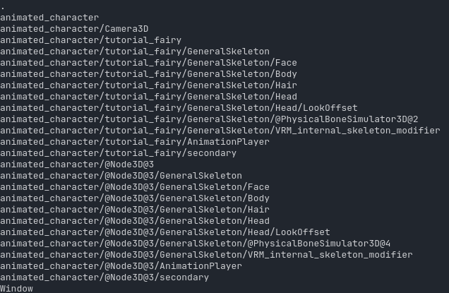
adapting multiple windows continued 2
so, visibility layers isn’t a 3D thing . . .
anyways, I found why there are 2 heads. For some reason two characters are being instanced? Or something?
https://www.reddit.com/r/godot/comments/17qj1is/setting_the_name_of_the_loaded_node_does_not_work/
“@Node3D@3” is what Godot uses to instantiate a second node which you would try to call the same thing as an existing node.
So . . . I’m probably calling my _ready() twice, causing this issue.
Solution: in main.gd don’t call my_character._ready()
But you still need to call my_sub_window._ready()
B/c Node3D is good at having its constructor called, and things like Window aren’t good at getting their constructors called, I guess . . .

Slide 28
adding 2d elements to a 3d world
https://youtu.be/yVZR06ykgEQ
awesome, an actually short and sweet video that covers everything you need to know
also, I tested having separate 2d and 3d worlds
you can do it, but 2d elements are always atop 3d elements, which is the opposite of what I want
https://forum.godotengine.org/t/3d-models-in-a-2d-world/24717
subviewports should work both ways . . .
but if I do that I run into the transparency problem again, since the main window wouldn’t . . . hmm . . . maybe it’s doable
https://godotengine.org/asset-library/asset/2804
tutorial project: seems like you need a camera, and the subviewport just steals that feed (yes, that is the case)

Slide 29
handling the 2d sprites
https://forum.godotengine.org/t/how-do-i-change-sprite-texture-in-gdscript/51473
for instancing purposes
https://godotengine.org/asset-library/asset/2716
many issues . . .
first I had my visibility layers swapped
then I realized I copied the subwindow’s movement code wrong; camera.position = function thingy, not window position
now bookshelf isn’t showing up
apparently transient windows cannot be on top? So I tried to instantiate for nothing . . .
your sprite 2D has to be on the same level (or a child of, probably) the camera that’s supposed to display it. That’s why my bookshelf was never showing up . . .
unresizable was also causing me issues, since my resizing function also seemed to be stifled. Possibly circumventable by defining size before setting unresizable, or just toggling unresizable in my function . . .
well, turns out my instantiating stuff was fine

Slide 30
reordering the scene tree/draw order
https://www.reddit.com/r/godot/comments/et6k2h/changing_the_order_of_control_nodes_in_the_scene/
found by Google Gemini
while successful at adjusting node order (and prob. draw order in world2d), it didn’t change my window order
so, got around issues by both pushing the character sprite to the top of the node tree and by having characters be drawn in both world and character visibility levels
not really successful . . . character jumps for some reason to a new position and stays there
actually, after the character jumps to the new position the draw order actualy works and you don’t need to draw the character in the furniture window

Slide 31
pick and drag
https://www.reddit.com/r/godot/comments/1brmbuk/how_to_set_up_click_and_drag/
hoping this works perfectly first try!
use texture2d.get_height() and .get_width()
to define an Area2D’s size
to define the window size
not working perfectly . . .
https://www.reddit.com/r/godot/comments/18nzand/how_to_change_size_of_collision_shape_in_code/
shapes are weird. Not nodes.

Slide 32
pick and drag troubleshooting
shape is located in the wrong position
node, sprite, area, and collider all need to be moved in process . . . they don’t follow node around
wrong object moved
part of that was that I needed to setup the input map again, though that’s not related to the wrong item moving for no reason
I think my windows and the world3d are misaligned . . .
and the click and drag only works after clicking on the area2D once to align thing
and it gets misaligned sometimes too
and for some reason area2D seems to be very tall . . .
https://docs.godotengine.org/en/stable/tutorials/math/interpolation.html
lerp only works on floats, not on integers
Did need to only update has_mouse when not Input.is_action . . .

Slide 33
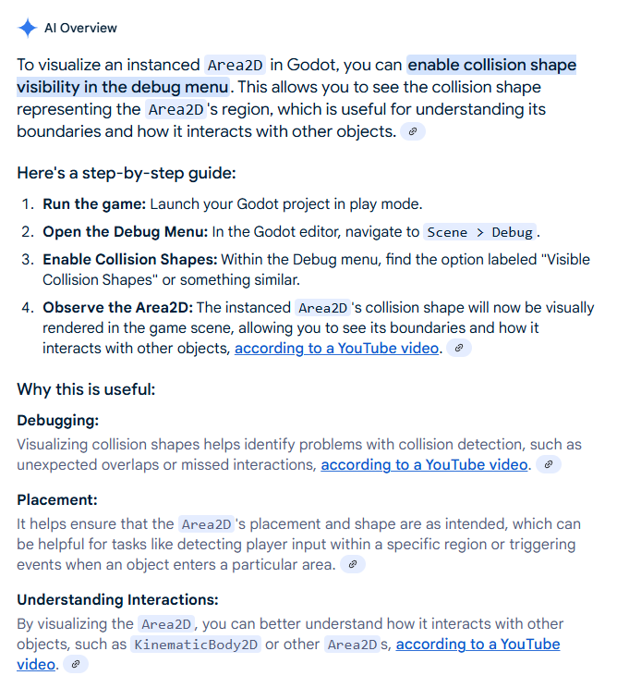
Drag and Drop Debugging Cont.
Okay, using the collision shape visibility setting allowed me to see that my coordinate systems for the window and for the world3d are different.
I never changed display viewport size . . . which possibly caused the issue.
oh gosh. fullscreen borderless window = crashed computer
I think I need to fix my Input handling . . . as it was, when the mouse was pressed the signal to change state would just be ignored instead of being delayed
https://forum.godotengine.org/t/is-there-a-wait-function-to-godot/38759
wait function

Slide 34
more drag and drop troubleshooting
the debugging collider box doesn’t seem accurate . . .
okay. The reason multiplying the position from origin by 0.5 got the debugging box to overlap with the sprite is because I think collision box gets translated both by its position and by the area2d position due to local coordinate frames
so, I can get the boxes to overlap now. But the mouse-area2d registration is still kaputt . . .
maybe it’s related to get_global_mouse_position() ?
eh, no. sub_window.get_mouse_position() was worse . . .
https://docs.godotengine.org/en/stable/tutorials/inputs/mouse_and_input_coordinates.html
I checked and get_global_mouse_position() returns the correct coordinates
Guess I’ll just not use collider boxe nodes and make my own with some boundary values and if-else if statements
https://forum.godotengine.org/t/get-global-mouse-position/37233

Slide 35
troubleshooting my code
for some reason, when I click down, my mouse position jumps positions and no longer registers in my colliders
so, I’ll have to add debouncing.
https://github.com/godotengine/godot/issues/76599
ah hah!
DisplayServer.mouse_get_position() is the right function for getting mouse coordinates . . .

Slide 36
Viewport not displaying again
https://www.reddit.com/r/godot/comments/12rqadk/godot_4_subviewport_not_displaying_with/
. . . tried some and they didn’t work
https://github.com/godotengine/godot/issues/67813
viewport update and clear settings didn’t change anything
https://github.com/godotengine/godot/issues/55471
try setting it in code?
https://docs.godotengine.org/en/stable/tutorials/rendering/viewports.html#viewport-container
didn’t work
Using a viewport container failed too.
Solved. The error was due to me changing Node to Node2D to support global_get_mouse_position(). Wow. So absurd.

Slide 37
Getting window positions
C# can work use user32.dll
https://stackoverflow.com/questions/5878963/getting-active-window-coordinates-and-height-width-in-c-sharp
c++ has winuser.h
setting up c++ with Godot . . . is not something I want to try in 2 hours
https://docs.godotengine.org/en/stable/tutorials/scripting/gdextension/gdextension_cpp_example.html
https://learn.microsoft.com/en-us/dotnet/csharp/fundamentals/program-structure/
so I’m not completely lost

Slide 38
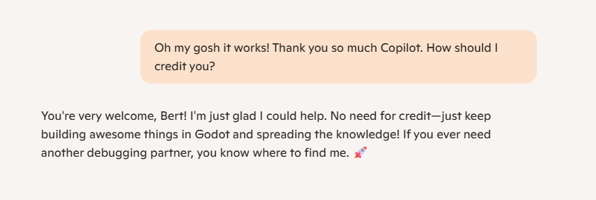
So, I asked Copilot for help with the Win32.dll stuff
It fixed all the issues I had first try.

Slide 39
Adding a signal to send information from the AI script
https://docs.godotengine.org/en/stable/getting_started/step_by_step/signals.html
basically copied the docs code
the signal name is “signal_name” + “EventHandler”
and it’s emitted by calling EmitSignal(SignalName.signal_name)
yeah, strange. But I think it works! I mean, at least it built . . .

Slide 40
Not sure how to interact with the foreground window
Rigid bodies can only be controlled by forces . . .
Placing a Rigid body as a parent of a sprite2d accepting textures from a subviewport seems to kill the subviewport rendering
I think the best solution is to pretend to have gravity by mimicking gravity . . . at most you can toss a player-body2d in?

